Slide 1


Welcome – Herzlich Willkommen
to
the
Faculty of Business Management
and
Economics
Foto: Gerhard Launer

Slide 2
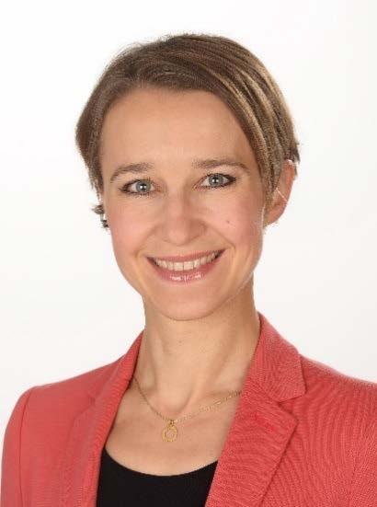

Contact Persons
Agata Stopinska, M.A.
Prof. Dr. Benedikt Franke
Exchange Coordinator
Email:
incoming@wiwi.uni-wuerzburg.de
Academic Supervisor
Email:
benedikt.franke@uni-wuerzburg.de
3

Slide 3
Today’s Topics
Buddy Programme
General Information
Campi of our Faculty
University Platforms
4.1 WueStudy
4.2 WueCampus
5. Registration for exams
6. Online Library, VPN client and eduroam (WLAN)
7. Get connected – Whatsapp group
Notes:
Link muss aktualisiert werden

Slide 4
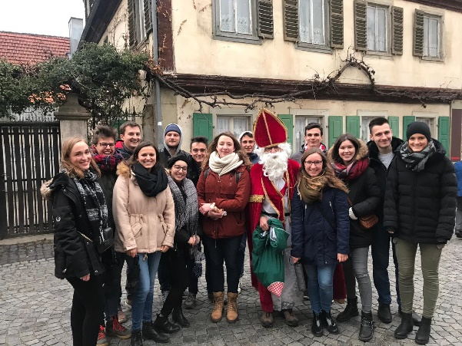


1. Buddy Programme
Implementation: April 2018
Goals:
  Connect exchange students with German students
  Quick orientation
  Answer your questions
  Assistance in finding your courses
  Tandem partner
  Having a lot of fun

Slide 5
1. Buddy Programme
First events of the semester:
13.10 (Monday): Meet & Greet at the University
13.10 (Monday): Wiwi Semester Opening Party at Posthalle
17.10 (Friday): Pub Crawl with Buddies
19.10 (Sunday): Wine Walk

Slide 6
2. General Information
Punctuality
  Even 5-10 minutes are considered as being late
Lectures:
10:00 a.m. – 12:00 a.m.🡪 means 10:15 a.m. – 11:45 a.m.
Lecturers might change their schedule slightly
E-Mail Correspondence
  Formal writing style
  Address receiver (Dear Prof. Dr. Franke)
  At the end:
  Mit freundlichen Grüßen /Best regards,
  [Full name]

Slide 7
2. General Information
GEZ: You have to pay a broadcasting fee which is €18,36 per month…Yes, even if you have no television or radio! After the registration at the city hall you should receive the letter with the information on the payment.
University sports offerings: with just €25 per semester, you can join as many sports courses as you like. However, for some sports, an additional fee is required (e.g. for the salsa course around €8).
  The University sports card must be bought online: https://www.hochschulsport-wuerzburg.de/cards

Slide 8
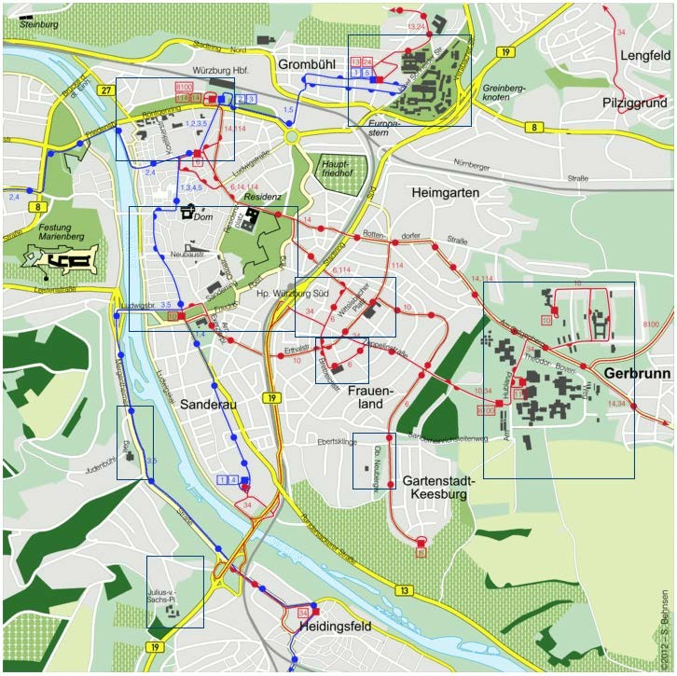
3. Campi important for you while stuyding at our Faculty
Hubland Nord:
International Office & Sprachenzentrum
Neue Uni (Sanderuni):
Student House Mensa/Cafeteria
Hubland Süd:
Mensa/Cafeteria& Library

Slide 9
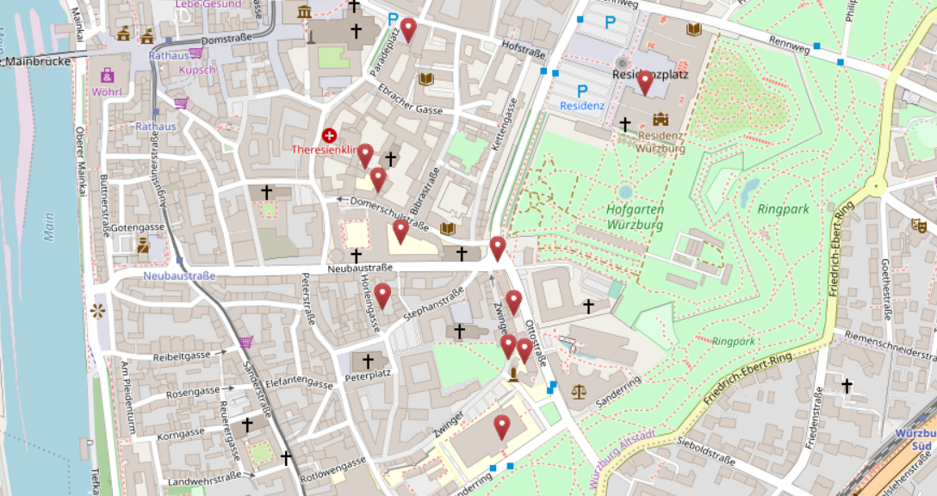
3. Campi of our Faculty
Alte IHK
Neue Uni

Slide 10
4. University Platforms
4.1 WueStudy
Administrative Platform
  Find courses
  Create timetable
  Register for exams
  Certificates, Transcript of records
Login with RZ account number
Link: https://wuestudy.zv.uni-wuerzburg.de/qisserver/pages/cs/sys/portal/hisinoneStartPage.faces

Slide 11
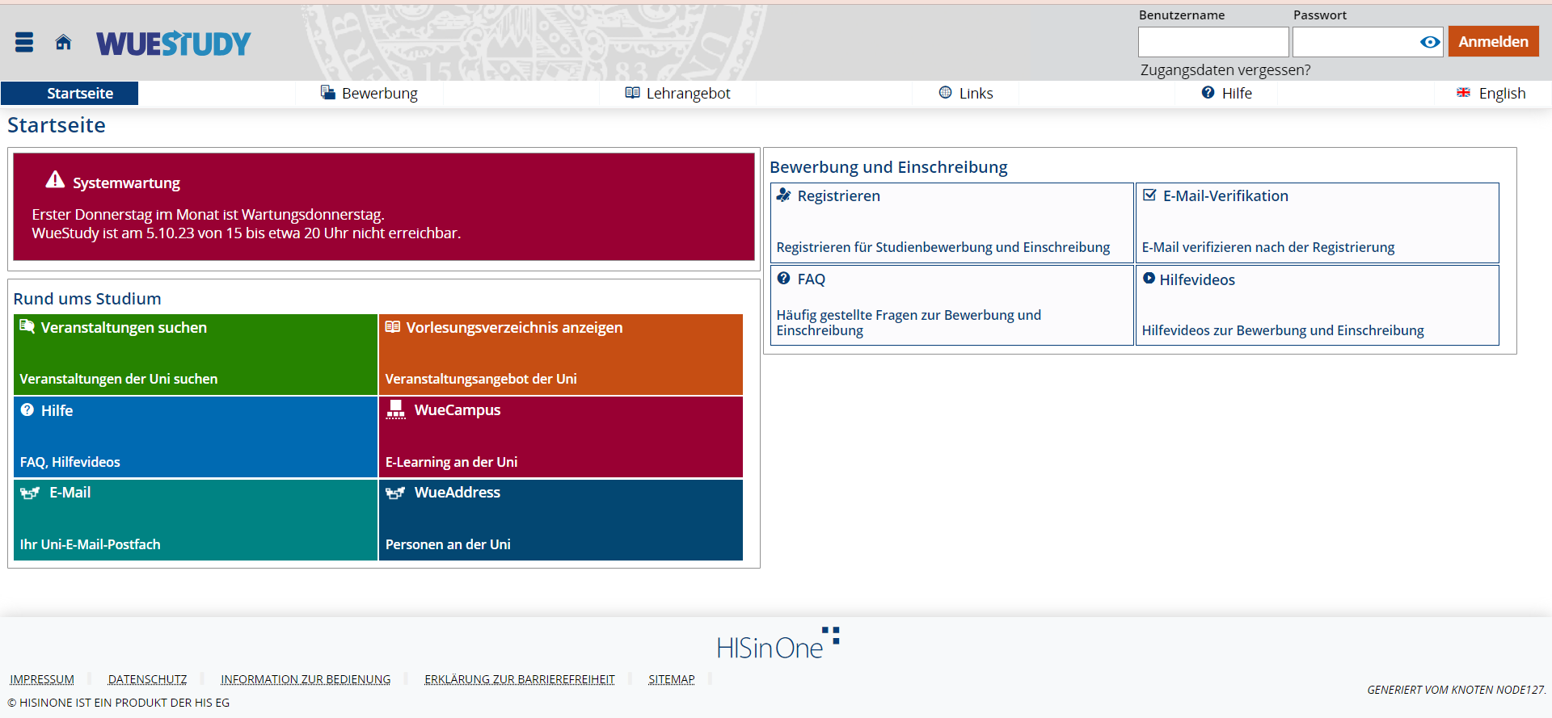
4. University Platforms - WueStudy 1.0
Log in and choose the language you prefer
Log in with s-number and password
select language

Slide 12
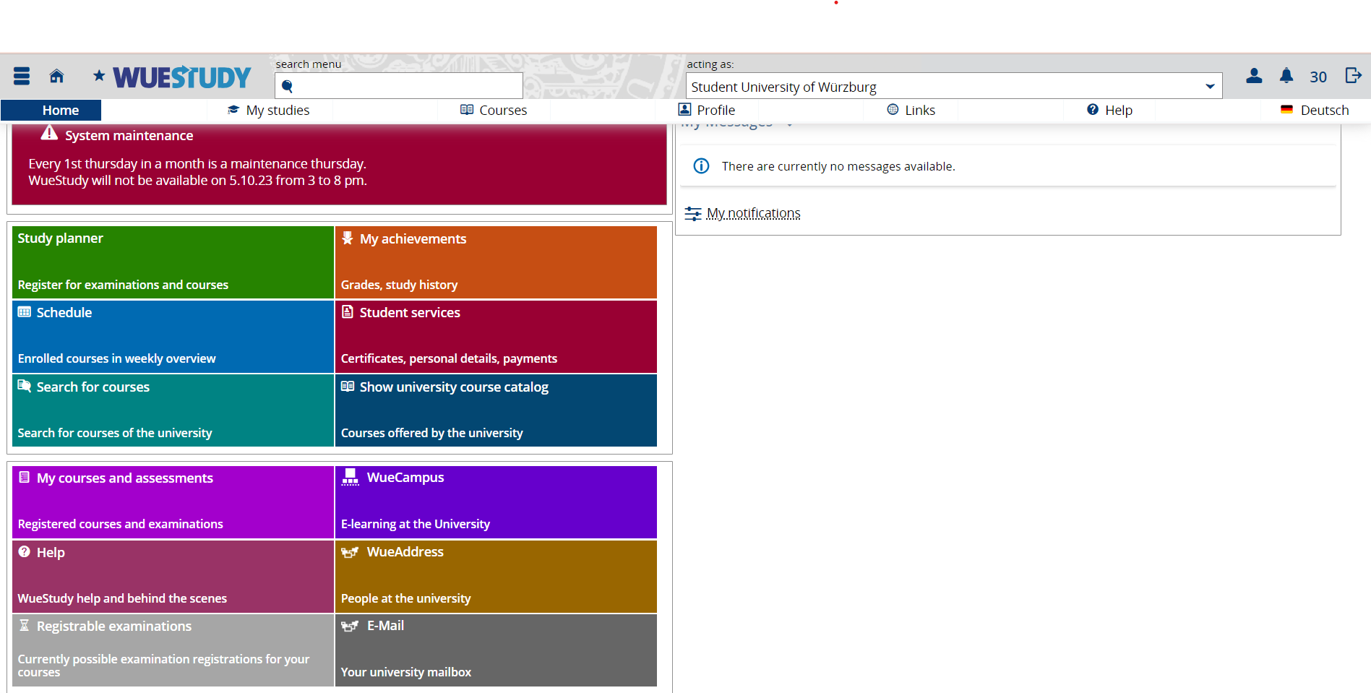
4. University Platforms – WueStudy 1.0
Download reports
select „student services“

Slide 13
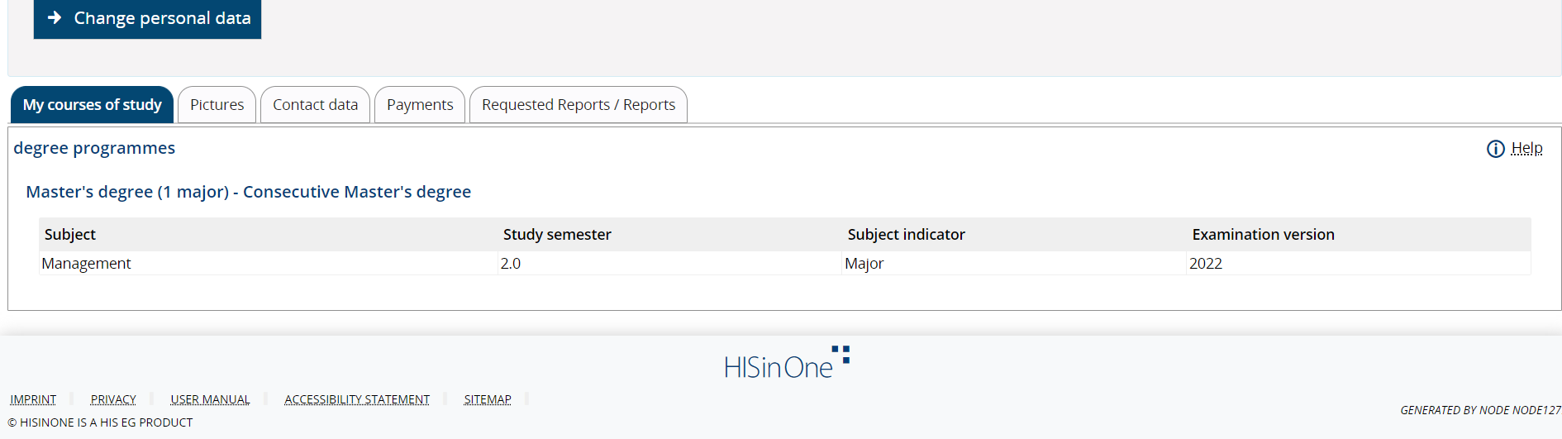
4. University Platforms - WueStudy 1.0
Download reports
select „requested reports/reports“

Slide 14
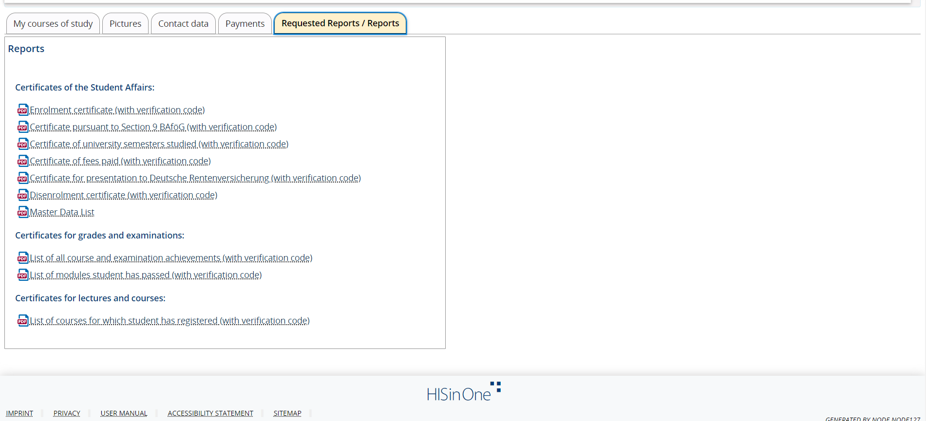
4. University Platforms - WueStudy 1.0
Download reports
„Enrolment certificate / Immatrikulationsbescheinigung“

Slide 15
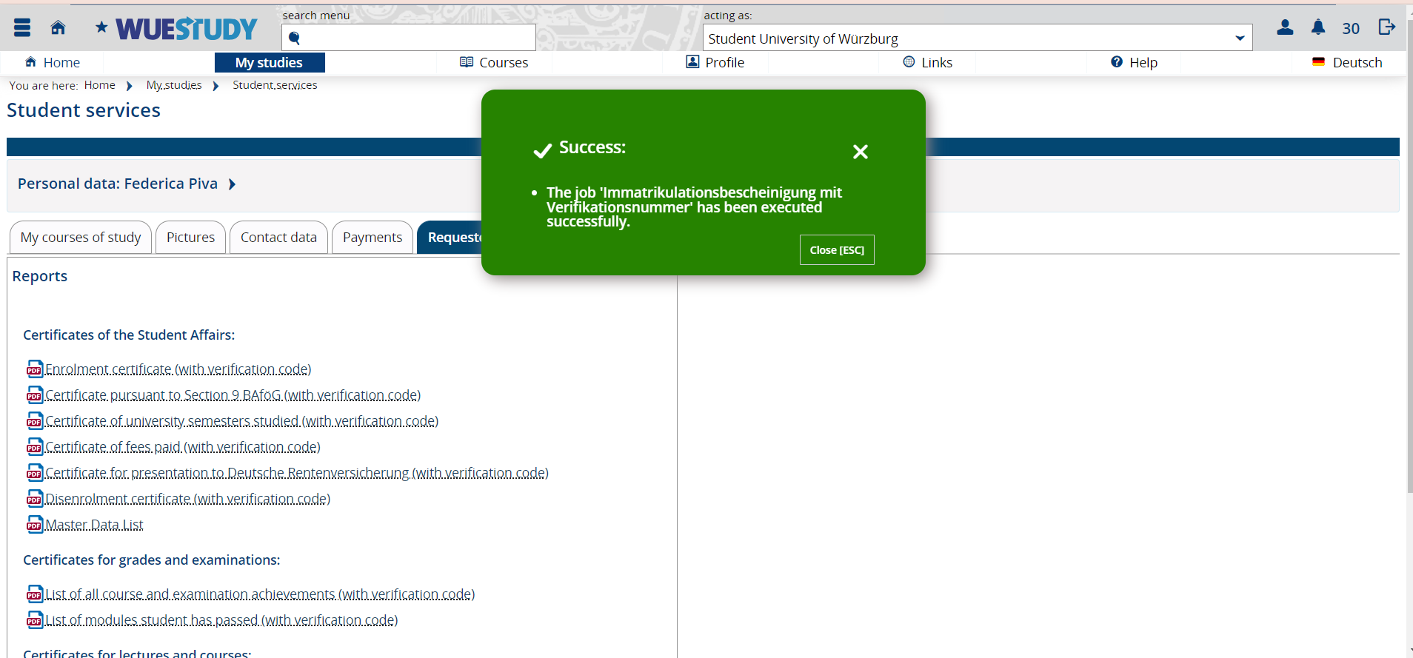
4. University Platforms - WueStudy 1.0
Download reports
downloaded successfully

Slide 16
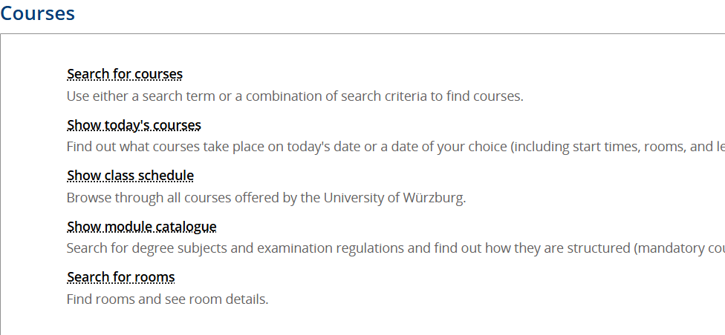
4. University Platforms - WueStudy 1.0
Search courses: 1st option
1: select „Courses“
2: select „Search for courses“

Slide 17
4. University Platforms - WueStudy 1.0
Search courses
you can also use the quicklink “search for courses”

Slide 18
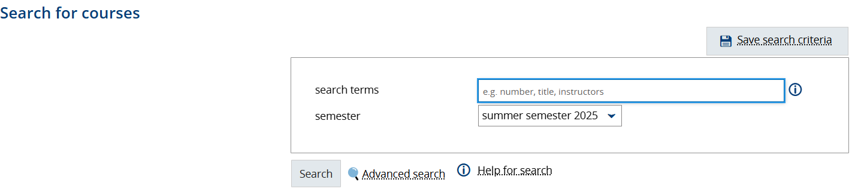
4. University Platforms - WueStudy 1.0
Search courses through course title/number
Enter the title or number of the course or the name of the lecturer

Slide 19
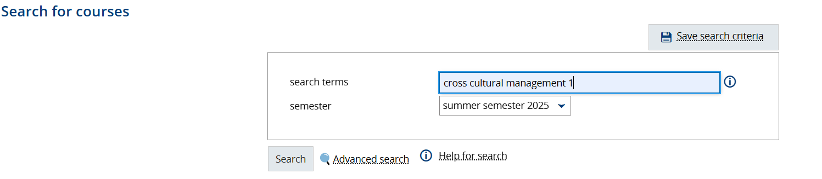
4. University Platforms - WueStudy 1.0
Search courses through course title/number
example

Slide 20
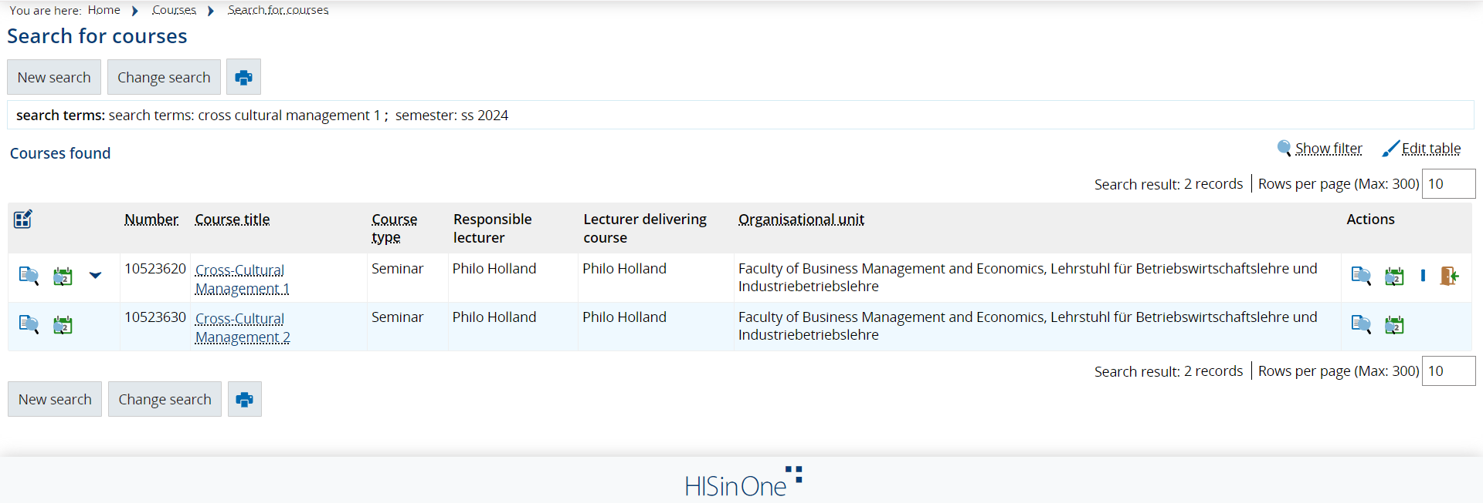
4. University Platforms - WueStudy 1.0
Search courses through course title/number
select course for more details (schedule, lecturer,..) and to add it to your schedule/ register

Slide 21
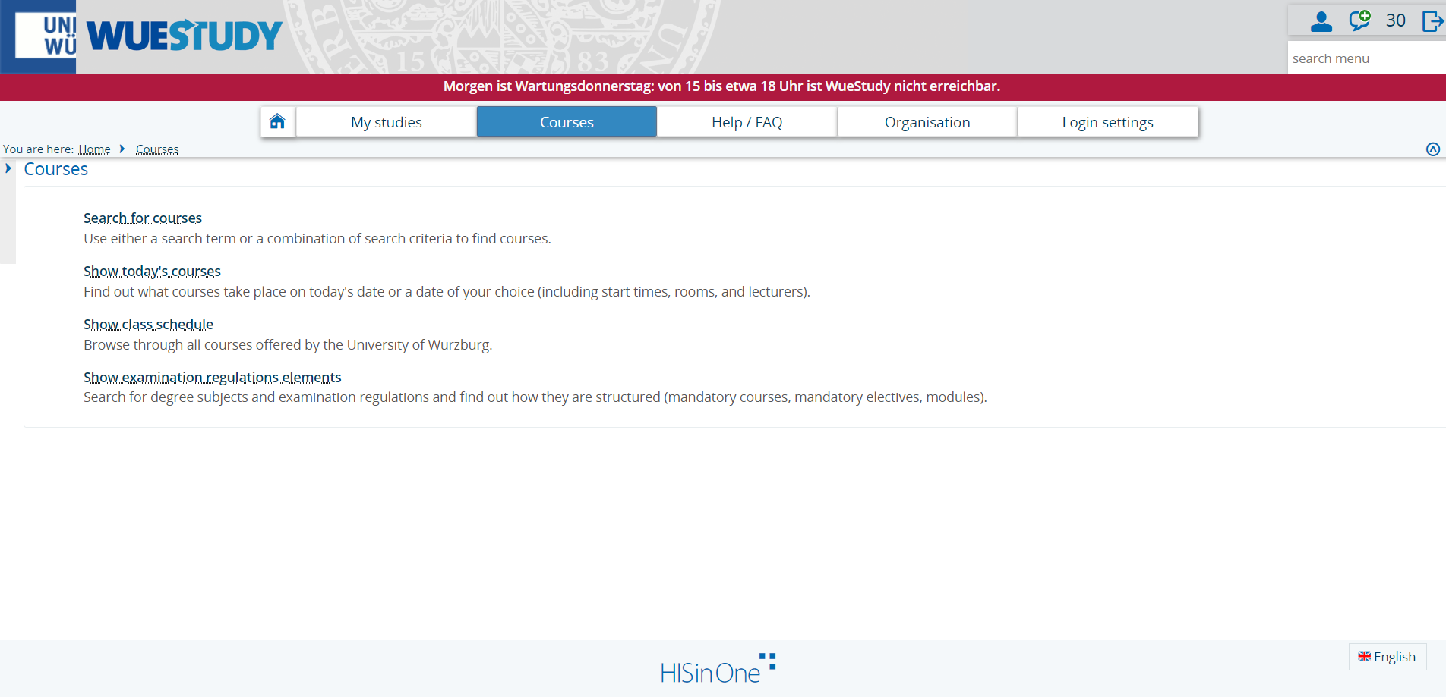
4. University Platforms - WueStudy 1.0
Search courses: 2nd option browse through all courses
1. click on „Courses“
2. select „Show class schedule“

Slide 22
4. University Platforms - WueStudy 1.0
Search courses: 2nd option browse through all courses
or go through the quicklink „Show university course catalog“

Slide 23
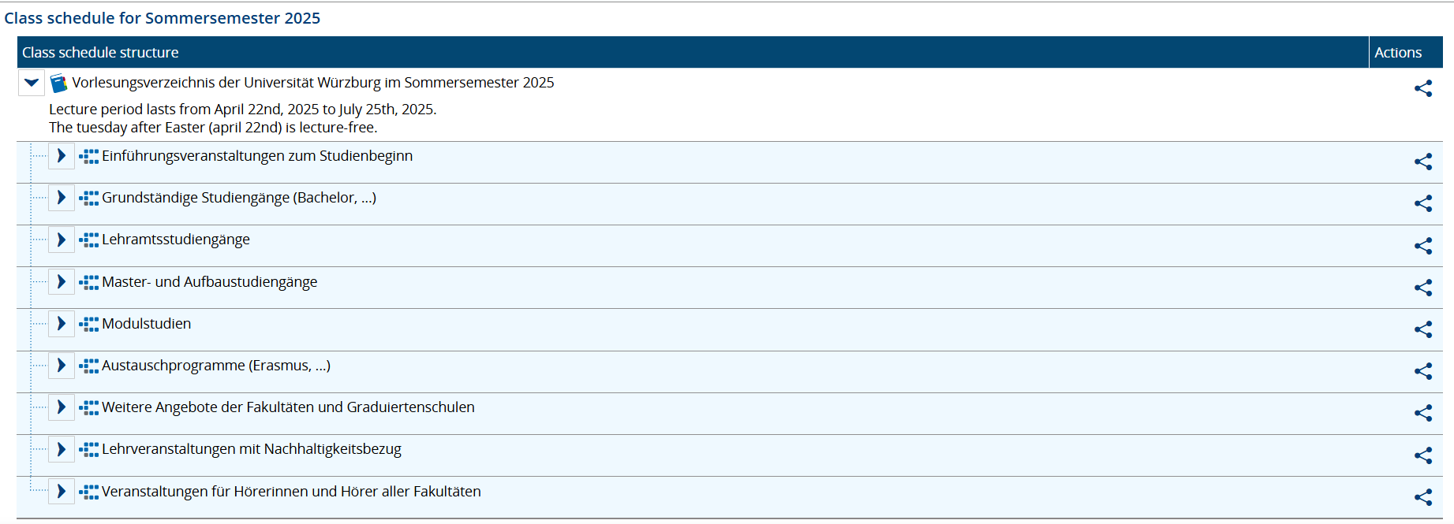
4. University Platforms - WueStudy 1.0
Search courses: 2nd option browse through all courses
Bachelor
Master
Exchange/Erasmus Bachelor and Master

Slide 24
4. University Platforms - WueStudy 1.0
Search courses: 2nd option browse through all courses
How to find all the English taught courses:

Slide 25
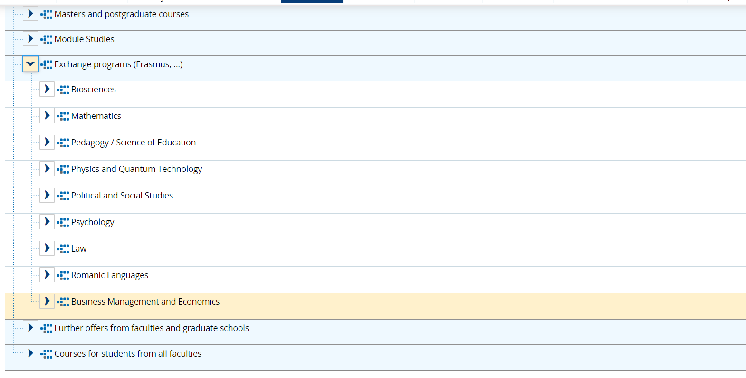
4. University Platforms - WueStudy 1.0
Search courses: 2nd option browse through all courses
= Wirtschaftswissenschaften

Slide 26
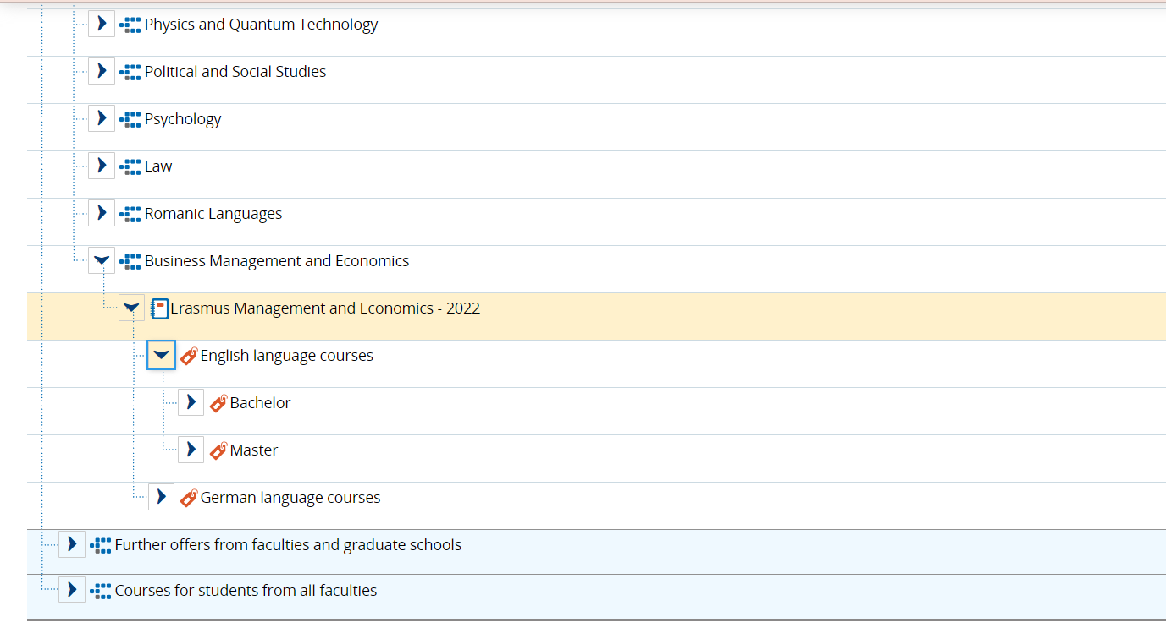
4. University Platforms - WueStudy 1.0
Search courses: 2nd option browse through all courses

Slide 27
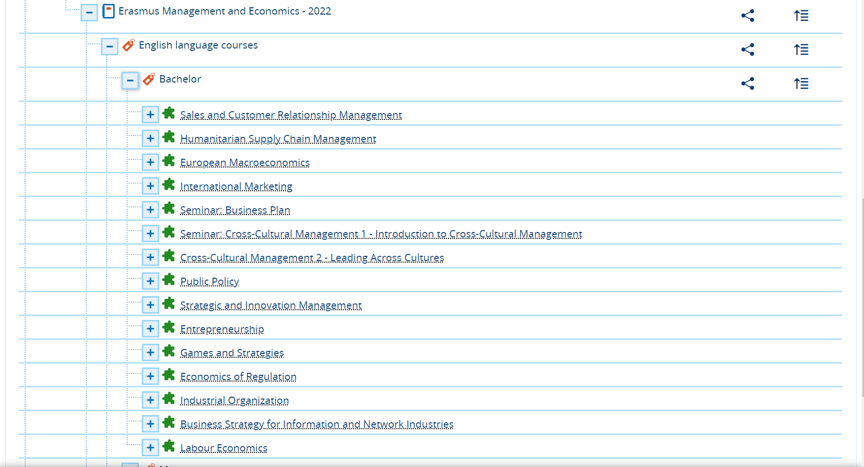
4. University Platforms - WueStudy 1.0
Search courses: 2nd option browse through all courses

Slide 28
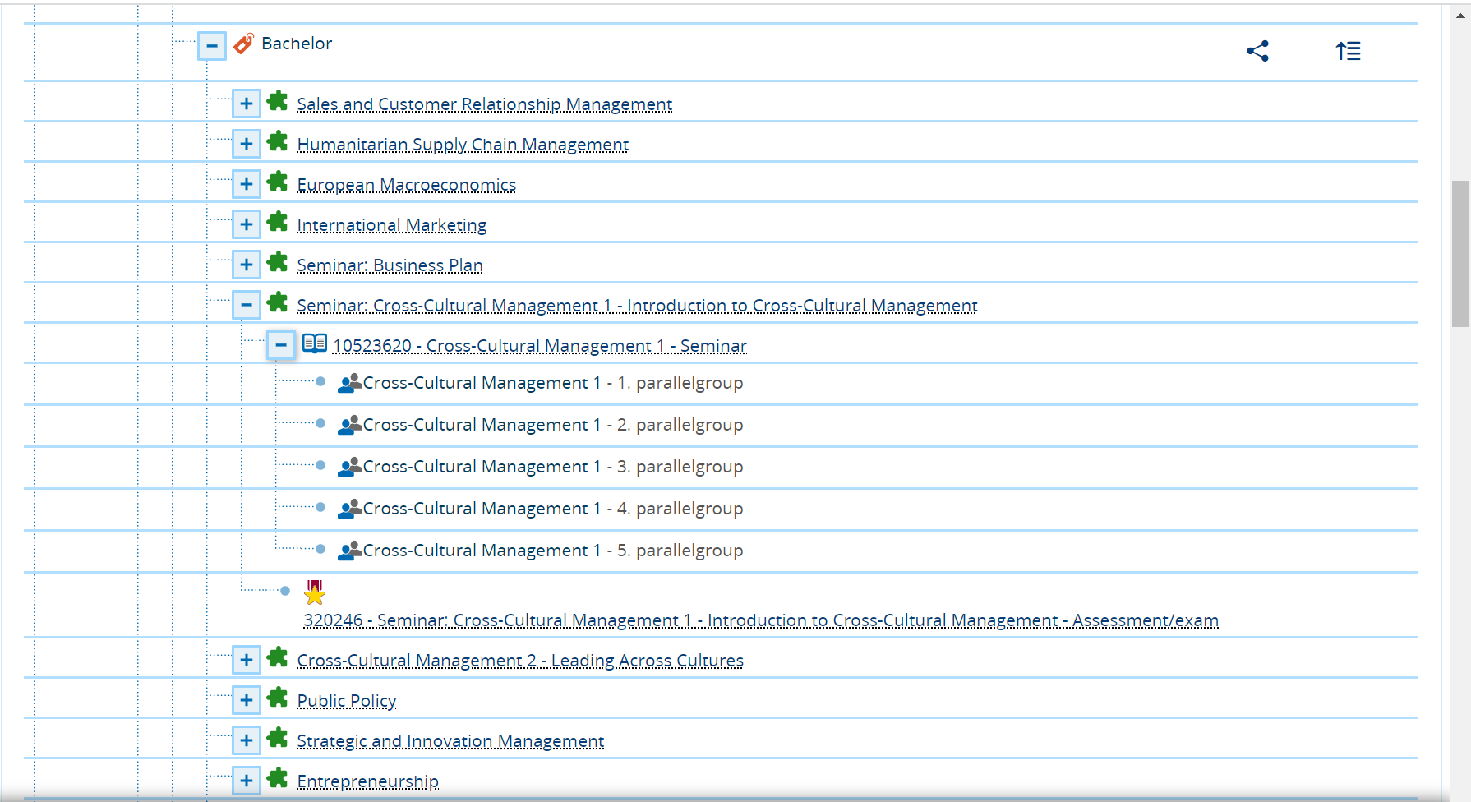
4. University Platforms - WueStudy 1.0
Search courses: 2nd option browse through all courses

Slide 29
4. University Platforms - WueStudy 1.0
Search courses: 2nd option browse through all courses
Further offers from faculties and graduate schools

Slide 30
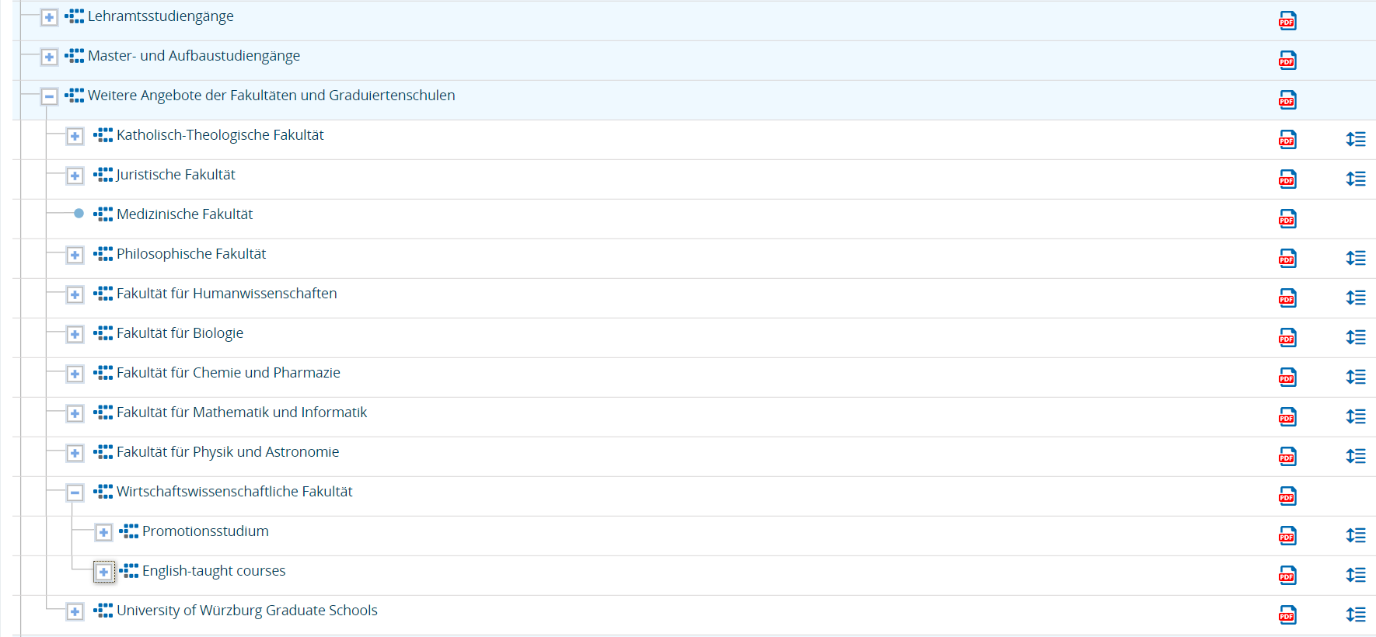
4. University Platforms - WueStudy 1.0
Search courses: 2nd option browse through all courses
select “Wirtschaftswissenschaftliche Fakultät”
select „English-taught courses“

Slide 31
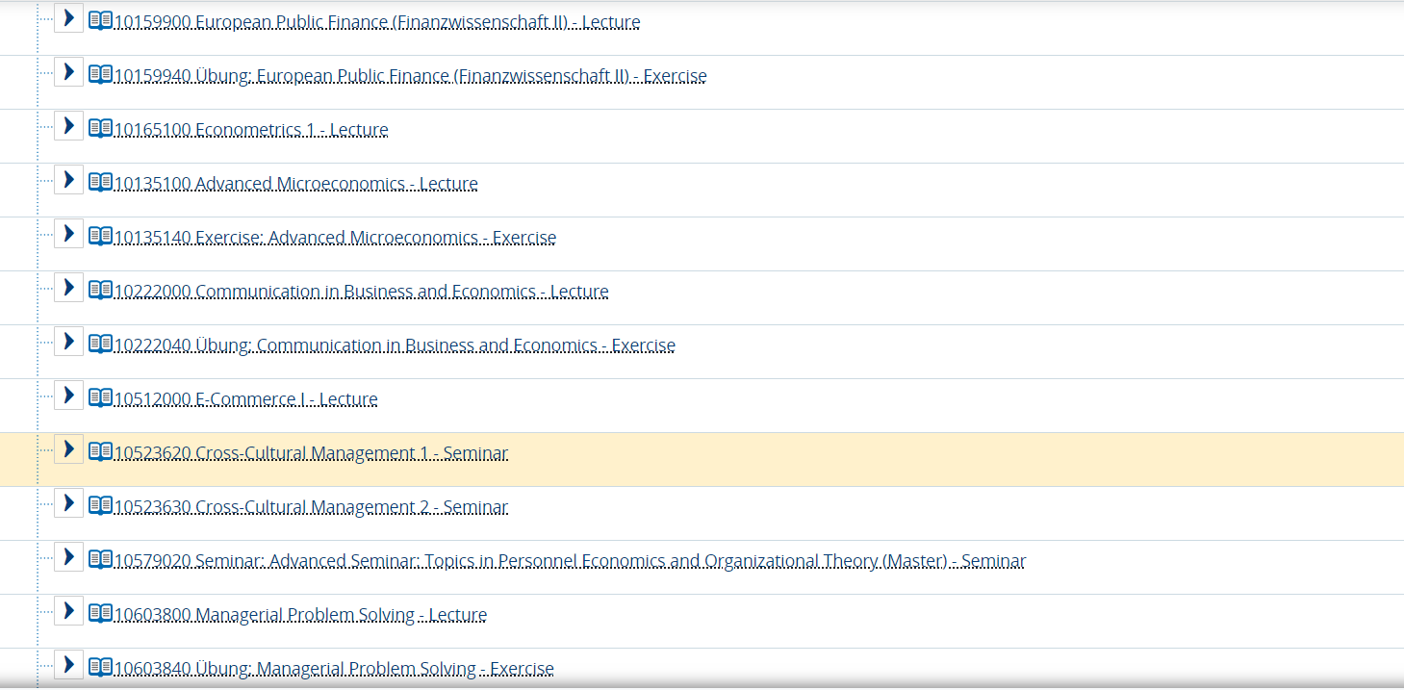
4. University Platforms - WueStudy 1.0
Search courses: 2nd option browse through all courses
Select any course you are interested in

Slide 32
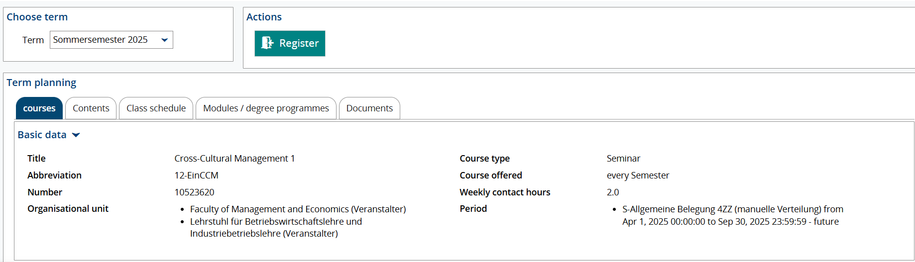
4. University Platforms - WueStudy 1.0
Search courses: 2nd option browse through all courses
click on the “register” button to register
registration period

Slide 33
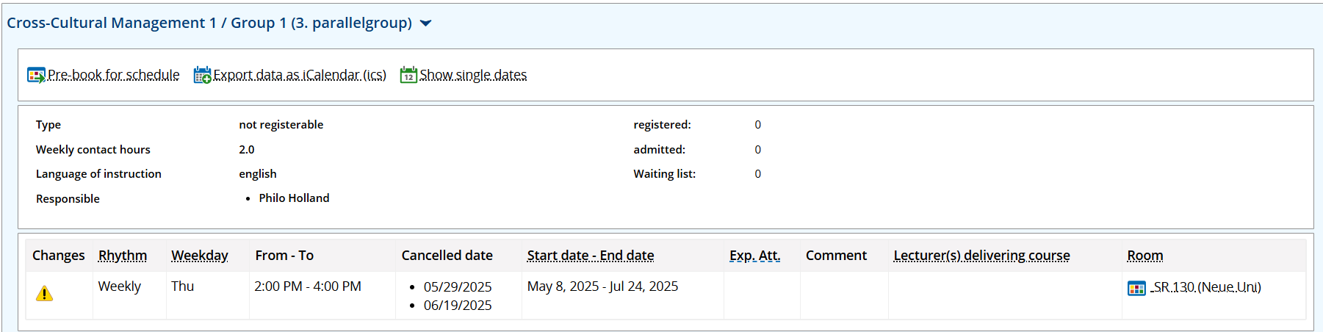
4. University Platforms - WueStudy 1.0
Search courses: 2nd option browse through all courses
course language
time
period/rhythm
place

Slide 34
4. University Platforms - WueStudy 1.0
Create your schedule
add to your schedule

Slide 35
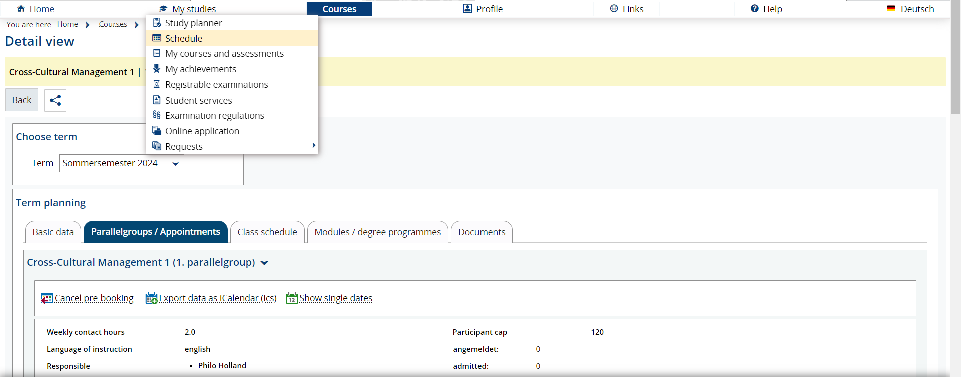
4. University Platforms - WueStudy 1.0
Create your schedule
go into “My studies” and select “schedule”

Slide 36
4. University Platforms - WueStudy 1.0
Create your schedule
or select “schedule” in the homepage

Slide 37
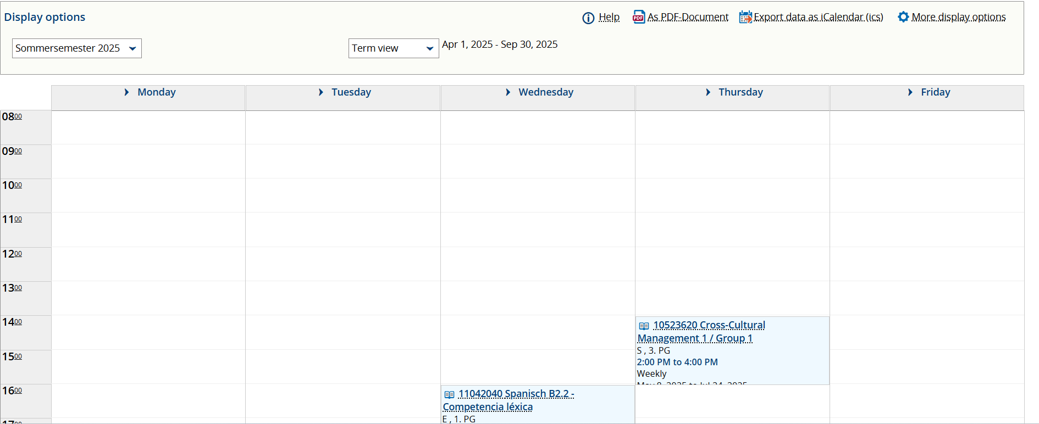
4. University Platforms - WueStudy 1.0
Create your schedule
download your schedule as a pdf document

Slide 38
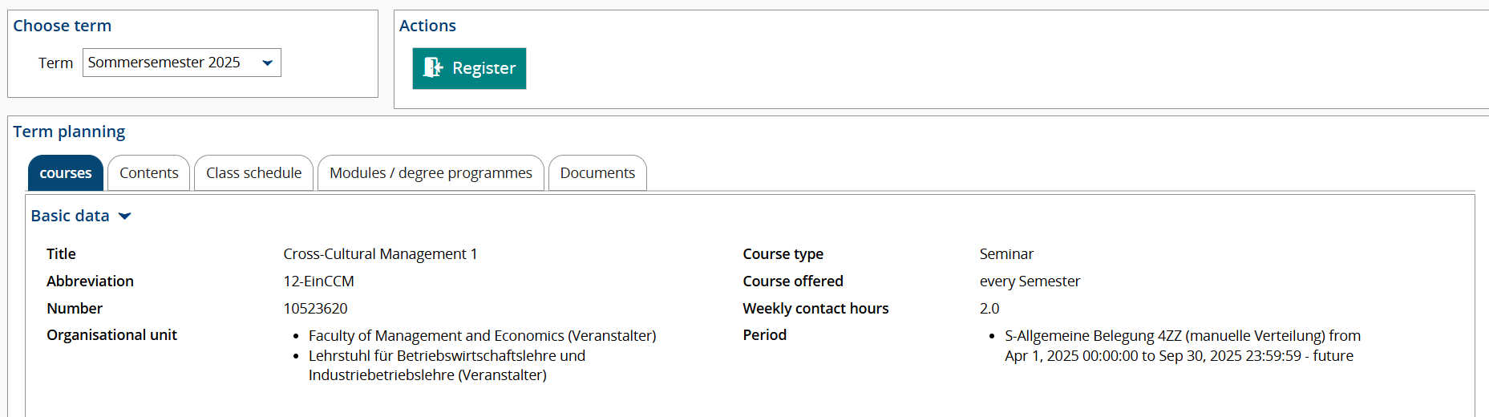
4. University Platforms - WueStudy 1.0
How to register for a course
click on the “Register” button to register for the course

Slide 39
4. University Platforms - WueStudy 1.0
Check if you have registered successfully and if you have been admitted to the course
select “My courses and assessments”

Slide 40
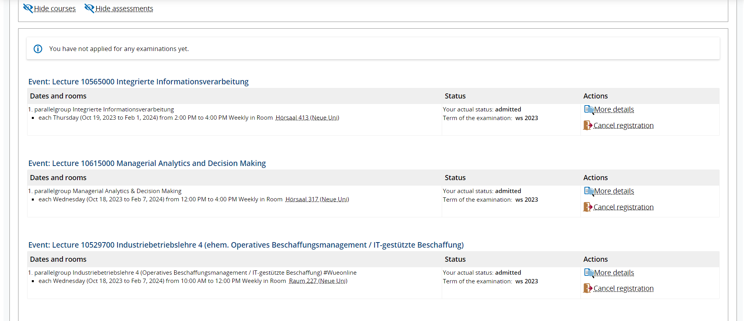
4. University Platforms - WueStudy 1.0
Check if you have registered successfully and if you have been admitted

Slide 41

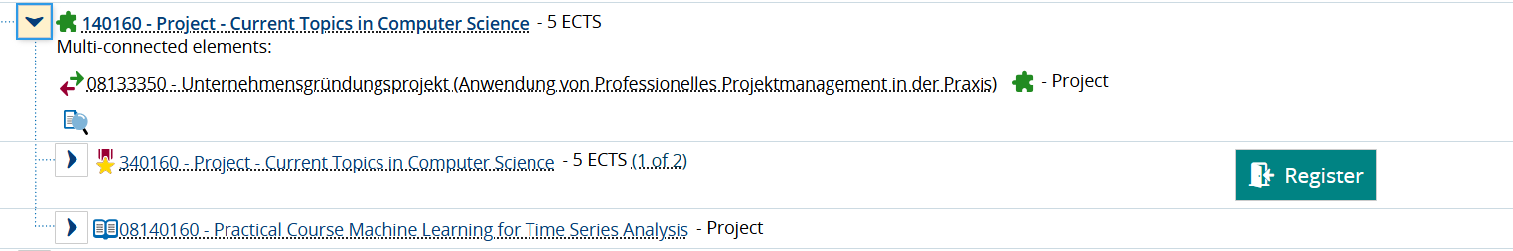
Registration for exams
Registration period for the exams: 15.11 - 16.12
The registration process is the same as for the courses: click on the “register” button to register. A notification will appear to confirm your registration

Slide 42
4. University Platforms - WueCampus
4.2 WueCampus
Online Learning Platform
  Find course material, syllabus, literature
  Communication channel
  Get updated
  Sometimes an enrollment password is required
Login with RZ Account number
Link: https://wuecampus2.uni-wuerzburg.de/moodle/

Slide 43
4. University Platforms - WueCampus
Get to your course platform Wuecampus

Slide 44
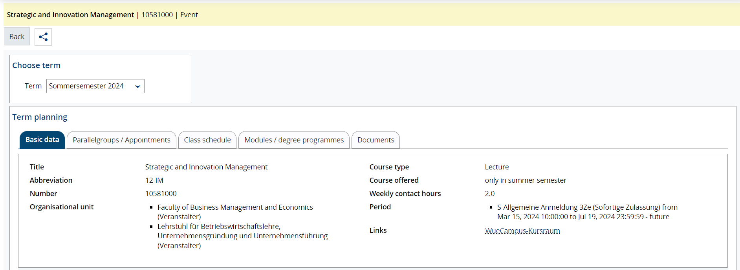
4. University Platforms - WueCampus
Get to your course platform Wuecampus via Wuestudy
most of the courses have already linked the moodle course in Wuecampus

Slide 45
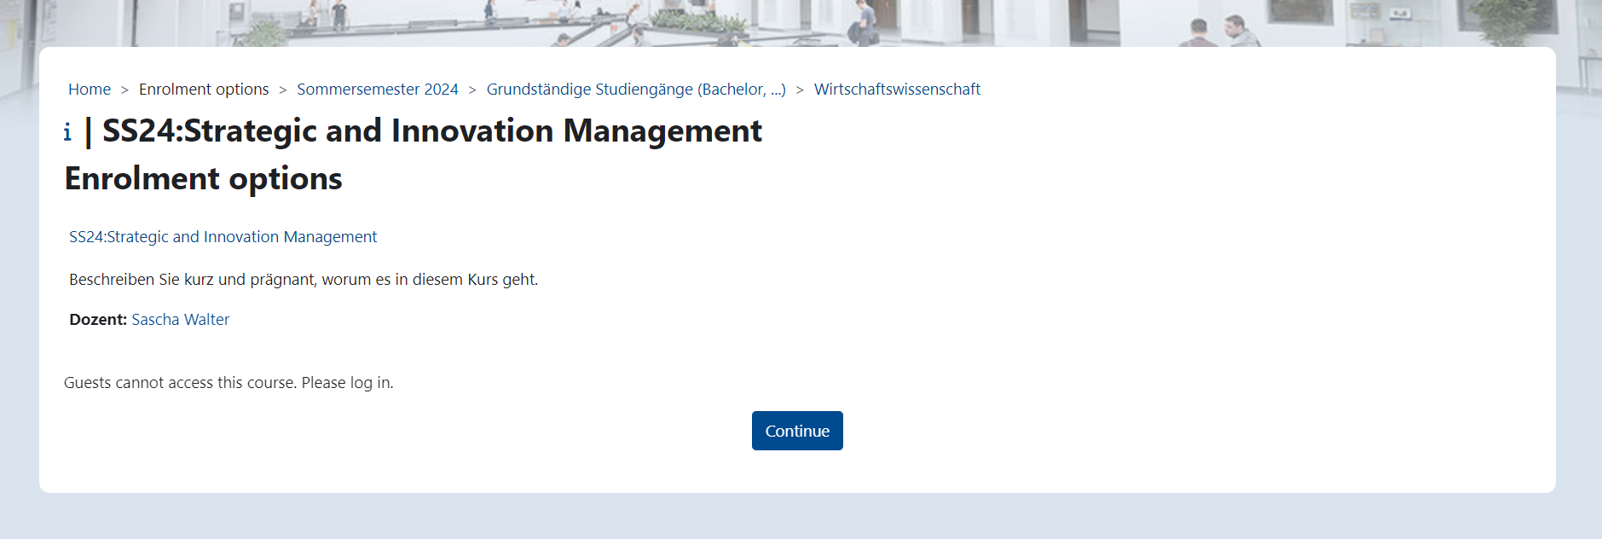
4. University Platforms - WueCampus
Wuestudy connection takes you to the online learning platform

Slide 46
4. University Platforms - WueCampus
To get to your courses on the WueCampus platform you can:
Use the link on WueStudy that you could find under the “basic data” of the course (as shown before)
or
Go to WueCampus and search among all the courses offered (explanation coming up)
However, the course will usually appear automatically on WueCampus after you have registered on WueStudy and have been admitted to the course, so you do not really need to do the course search on WueCampus:)

Slide 47
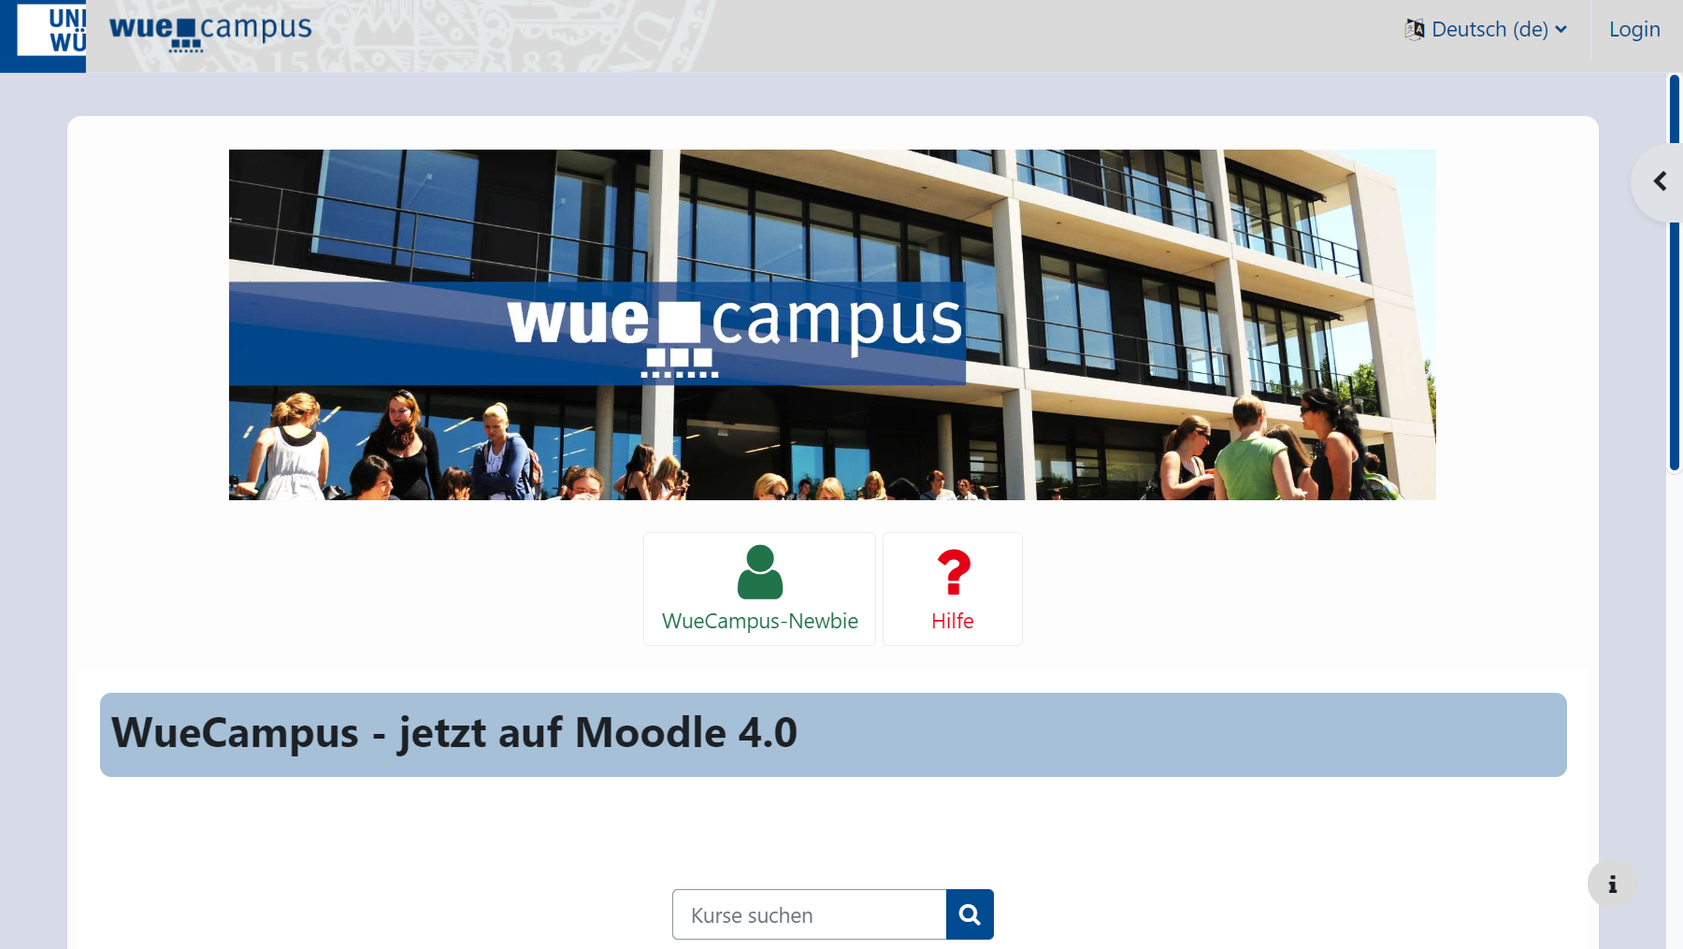
4. University Platforms - WueCampus
Log in and choose the language you prefer
log in with s-number and password
select language

Slide 48
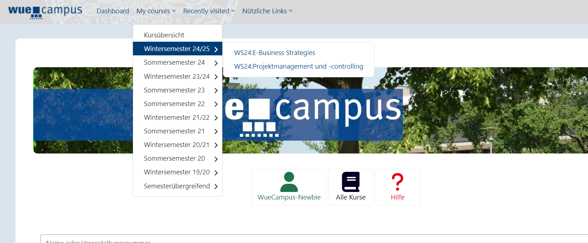
4. University Platforms - WueCampus
1 or 2 days after having registered on WueStudy and having been admitted to the course, the course should appear on WueCampus under “My courses” -> “Sommersemester 25”
ATTENTION: If some days after registration on WueStudy the course doesn’t appear on WueCampus, make sure you have been admitted to the course (see slide 39) or that the registration period is over. For courses with limited spots you will get access on the WueCampus room only after the registration period is over!

Slide 49
4. University Platforms - WueCampus
Enrollment options for WueCampus if you don’t get access automatically after registration:
Options to get into WueCampus | What to do
Self-registration | Login to your WueCampus account and click on self-enrollment
Password given in Wuestudy course information | Login to your Wuecampus account and enter the password to enrol
Additional information in Wuestudy | Read the info in Wuestudy/Chair’s homepage
Password given via email request | Send an email to get the password

Slide 50
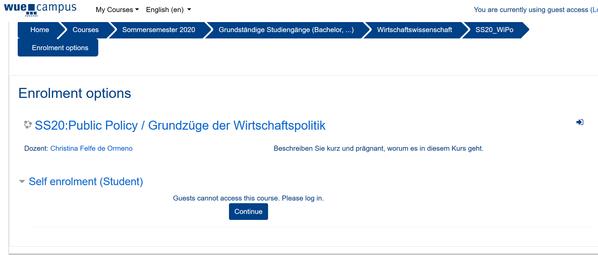
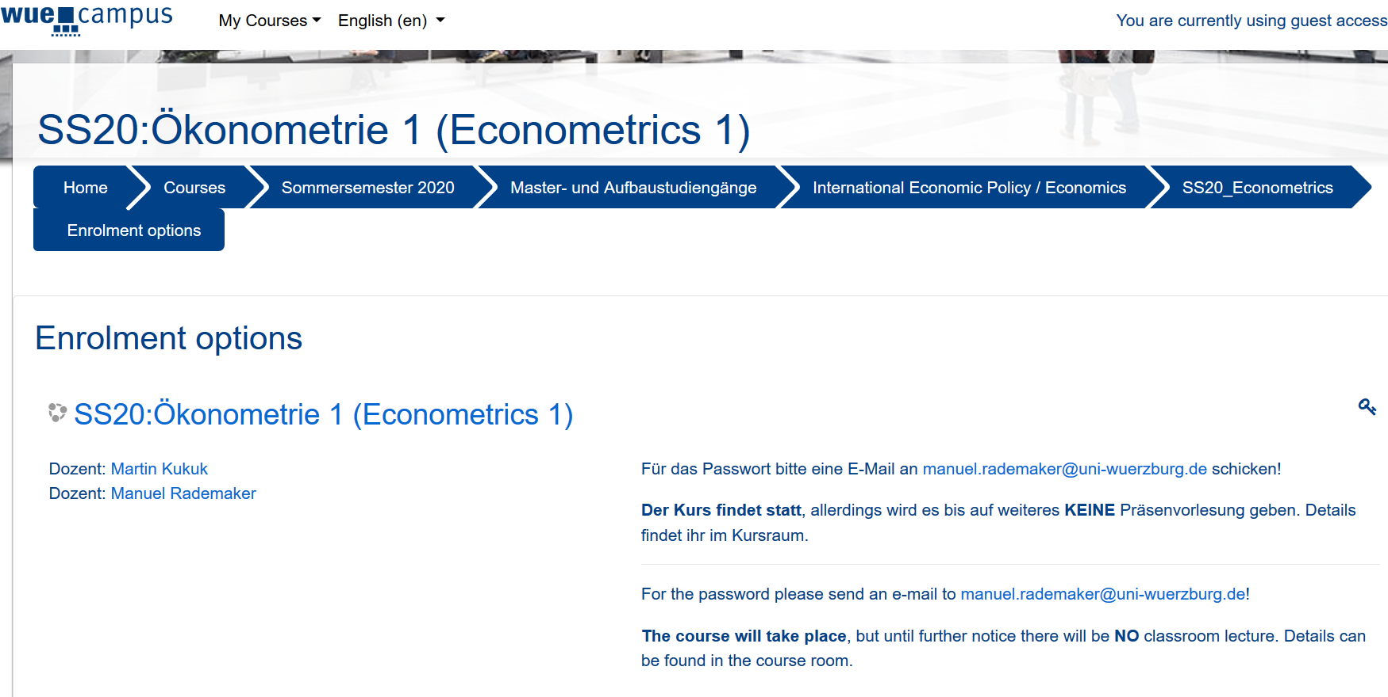
4. University Platforms - WueCampus
Login and do the self-enrollment
Get the password via emailing to the professor: email is written in the WueCampus platform

Slide 51
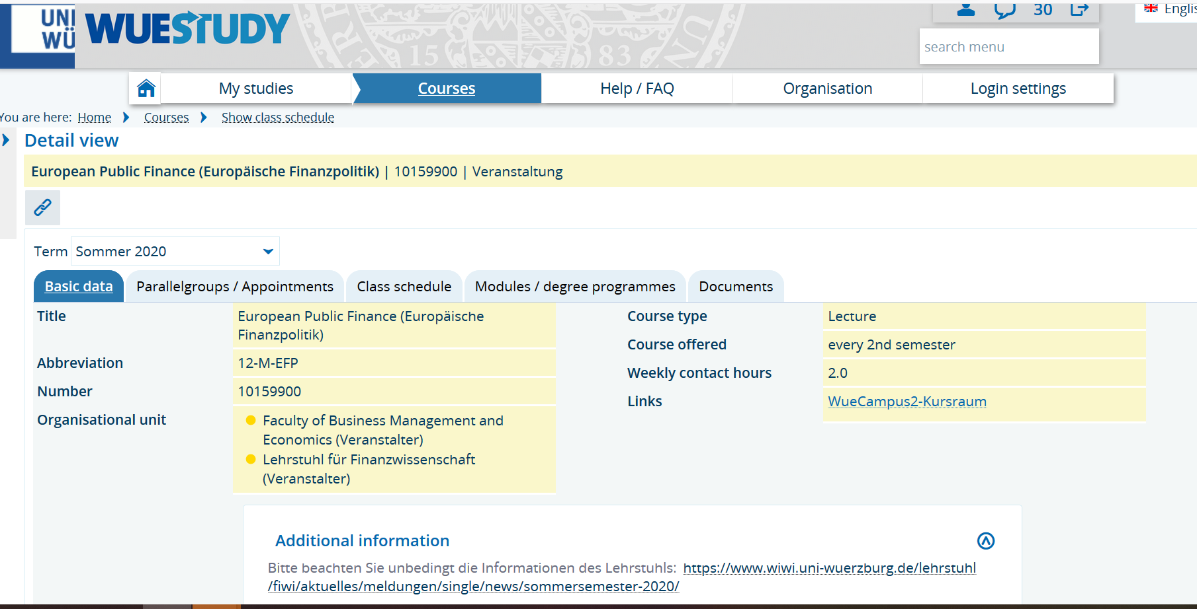
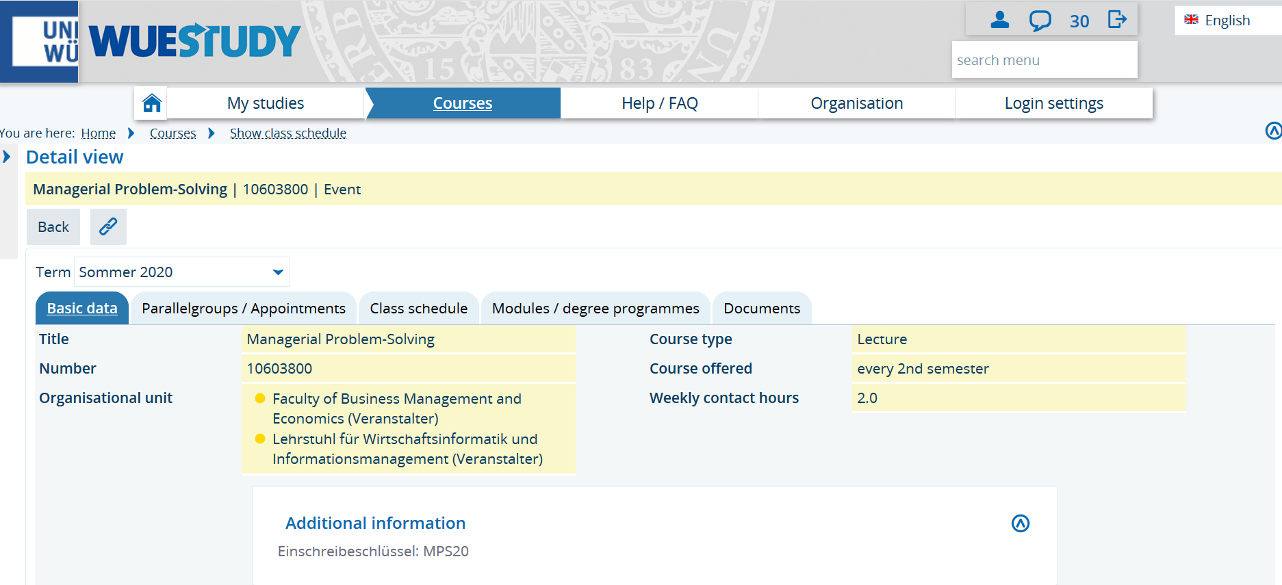
4. University Platforms - WueCampus
Additional information how to enroll on the Chair’s Homepage (click on the link in Wuestudy)
Password to enroll given in WueStudy (German Word for enrollment password is „Einschreibeschlüssel“)

Slide 52
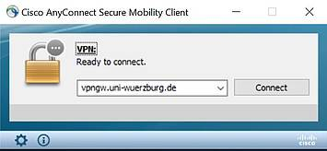
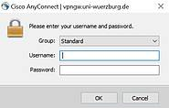
5. Online Library, VPN client and eduroam
Connect to our university network - VPN client
Install Cisco VPN Client
go to https://vpngw.uni-wuerzburg.de
use your s-number and password to sign in
select download type according to your system
run the downloaded file (.exe)
2) Establish a connection
start the programme
click on connect
login with your S-number and password

Slide 53
6. Online Library, VPN client and eduroam
Library
Please check the opening hours. On public holidays it is usually closed
https://www.bibliothek.uni-wuerzburg.de/
Online resources
Online Available resources of our university library
connect to the VPN client
go to https://katalog.bibliothek.uni-wuerzburg.de/ and log in
use online available literature
Further licenses
Beck eLibrary
ProQuest Academic Complete
IGI Global

Slide 54
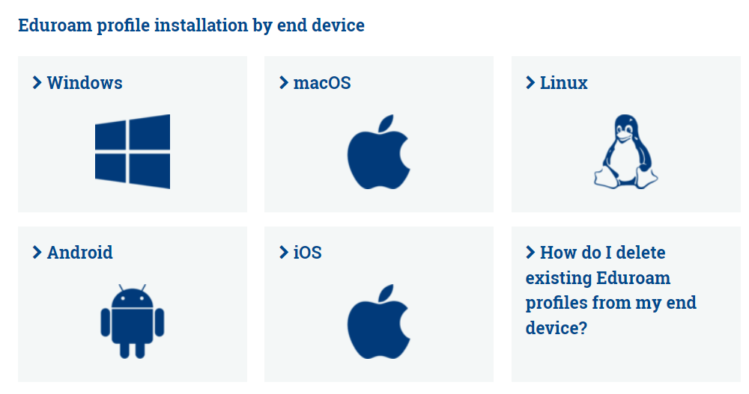
6. Online Library, VPN client and eduroam
Eduroam (WLAN)
Here you will find the information for the configuration of eduroam WLAN: https://www.rz.uni-wuerzburg.de/en/services/communication-services/wifi-wireless-network/wlan-eduroam-configuration/
Connect to “BayernWLAN” before starting the procedure (if you are doing it from your laptop or tablet)
Select your end device (iOS, Android, Windows..) and follow the instructions!

Slide 55
Questions?
For any question you can write to: buddy@wiwi.uni-wuerzburg.de

Slide 56
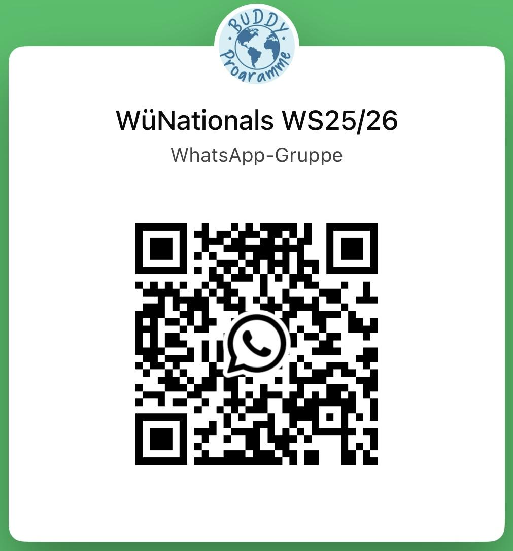


7. Get connected
https://chat.whatsapp.com/DZ5qE0iIn41BqKFoEiHKhr
wiwiuniwue
58

Slide 57
Thank you & have a nice time!
Danke für Eure Aufmerksamkeit!
Foto: Gerhard Launer

